Slide 1
Coffee, Tee, Mate and Seasoning Import and Export Austria Prediction
Andreas Ranzmaier and Lea Treml

Slide 2


Fitzgerald
Andreas
Data Preprocessing
ML & Neural
Analysis
Main Coder
Lea Treml
Baseline & Statistical
Documentation
Analysis
Pitchdeck
HOW MUCH
DO WE NEED TO
SHIP?
https://github.com/andreasranzmaier/TIS3-Fitzgerald

Slide 3
Problem
Import values rising – why is that? Only value?
Demand growth vs. price inflation unclear
No reliable short-term forecast for planning
Risk of wrong economic & business decisions

Slide 4
Data Source
STATcube Außenhandle ab 2007; KN 2-Steller
We decided to go for 14 years
(except the 3 months that were not yet available for 2025)
2007 to 2025 monthly data with 2 years val and 2 years test
Section 9: Coffee, Tea, Mate, Spices
We looked at Import and Export Quantities (kg) and values (EUR)
Notes:
https://www.statistik.at/statistiken/internationaler-handel/internationaler-warenhandel/importe-und-exporte-von-guetern

Slide 5
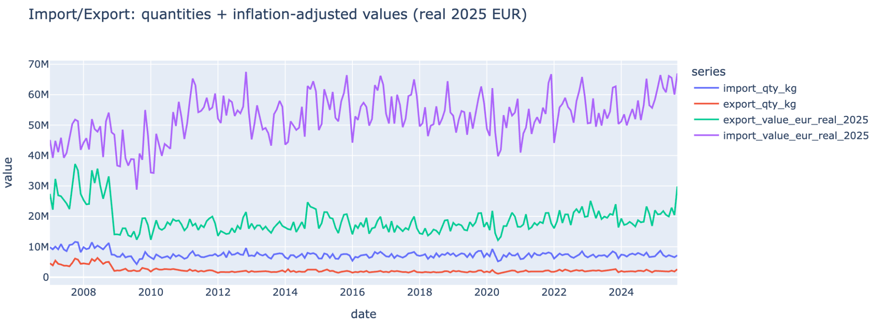
Data
Engineering
4 aggregations available
Import and export in eur and kg

Slide 6
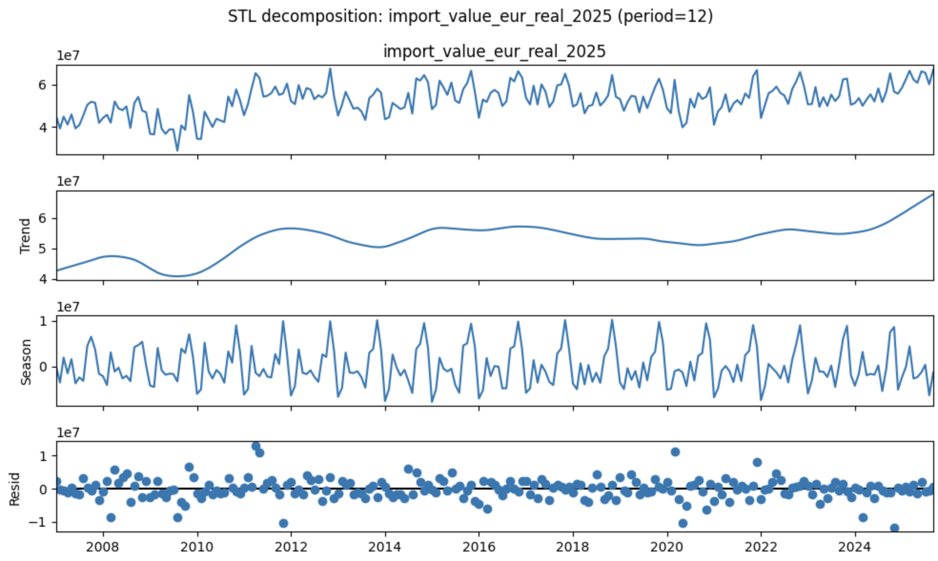
Looking at the SDL Decomposition

Slide 7
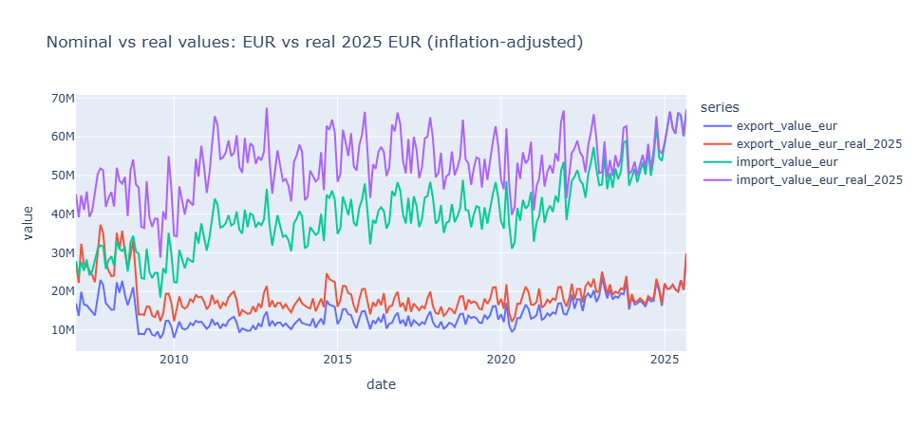
Data
Engineering
Cleaned raw CSVs and reordered months
Standardized timestamps and column names
Converted values to inflation adjusted value

Slide 8
Solution
Clean & Inflation-adjusted data
Analyze seasonality, trend and stationarity
Compare baseline, statistical, ML and neural models
Produce short-term forecasts up to Jan 2026

Slide 9
Modelling
Baseline: Naive, Seasonal Naive, Historic Average
Statistical: Random Walk, ARIMA, Auto-ARIMA
ML: Linear, Ridge, Random Forest, Gradient Boosting
Neural: RNN, MLP, N-Beats, NHITS
Baseline for performance floor
Statistical to see trend & seasonality
ML for nonlinearity
Neural more complex dynamically
Notes:
14 models in total

Slide 10
Best Performing Models
Evaluation
Time-based split for Train, Val, Test splits
Metrics: MAE, RMSE, MAPE, R2, OPE
Visual forecast comparison

Slide 11
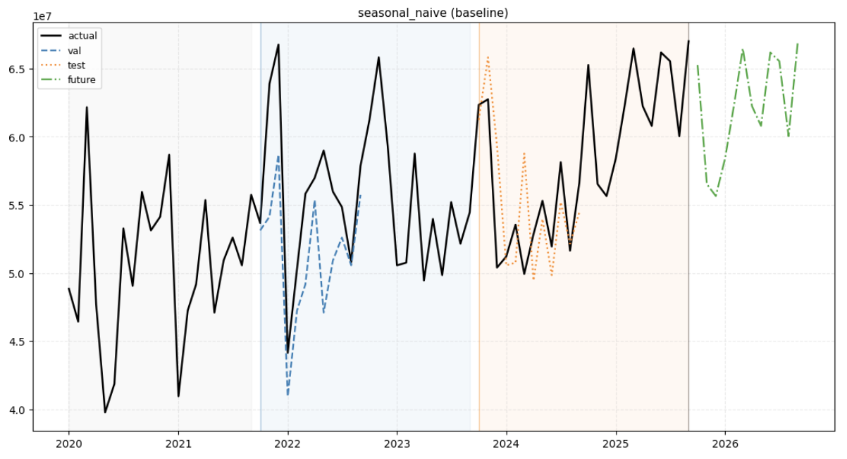
Seasonal Naive
strong monthly swings

Slide 12
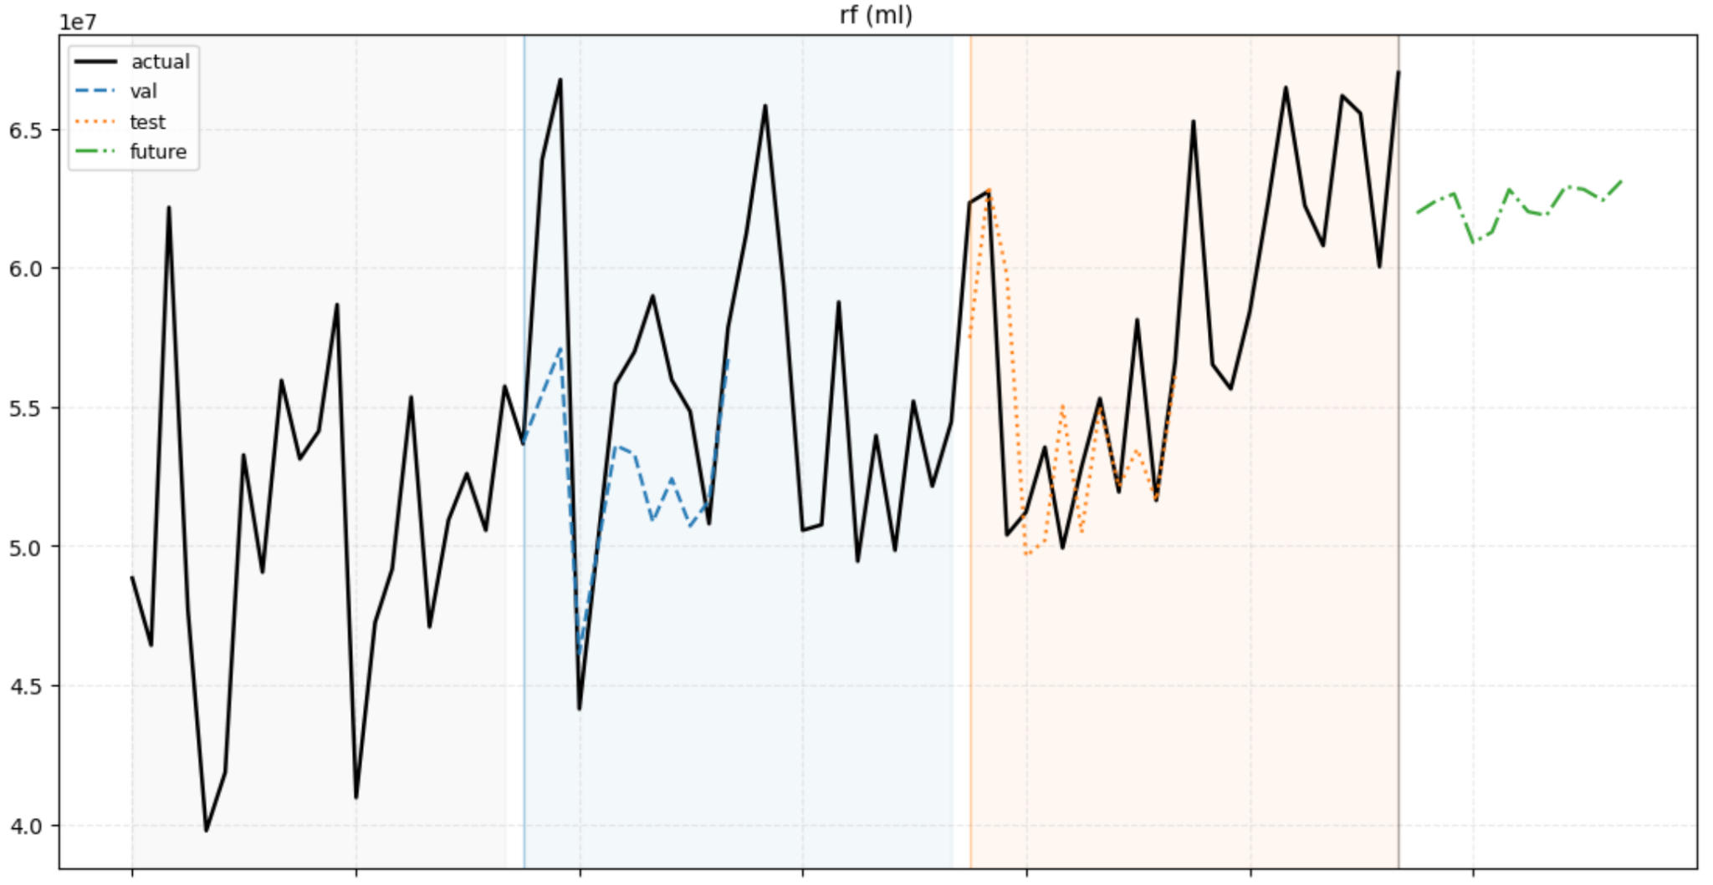
Random Forest
smooth, conservative forecasts

Slide 13
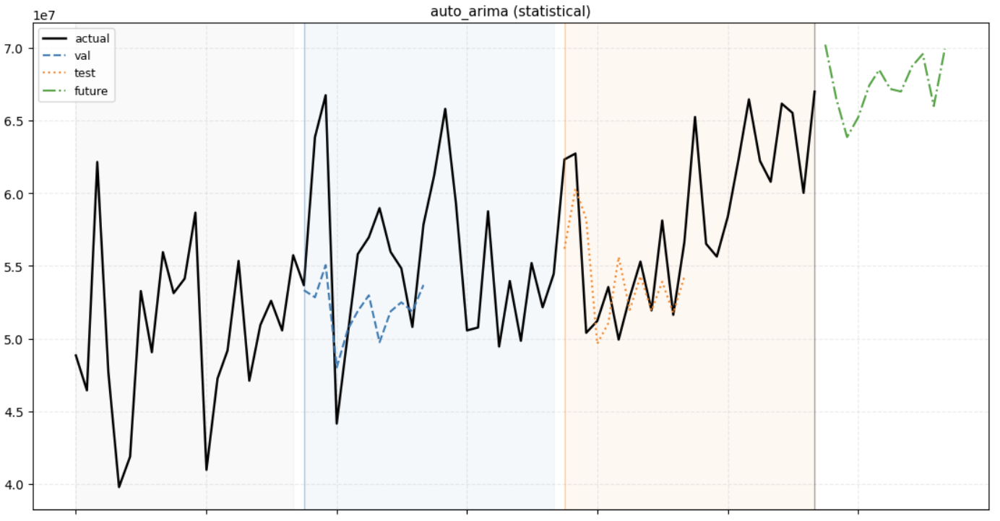
Auto-ARIMA
Sort spike with upwards trend

Slide 14
Forecast
Auto-ARIMA: good seasonal modeling of the spikes and also the trend
RF: smooth, conservative forecasts
Seasonal Naive: strong monthly swings weak trend
October 2025 data enables partial validation

Slide 15
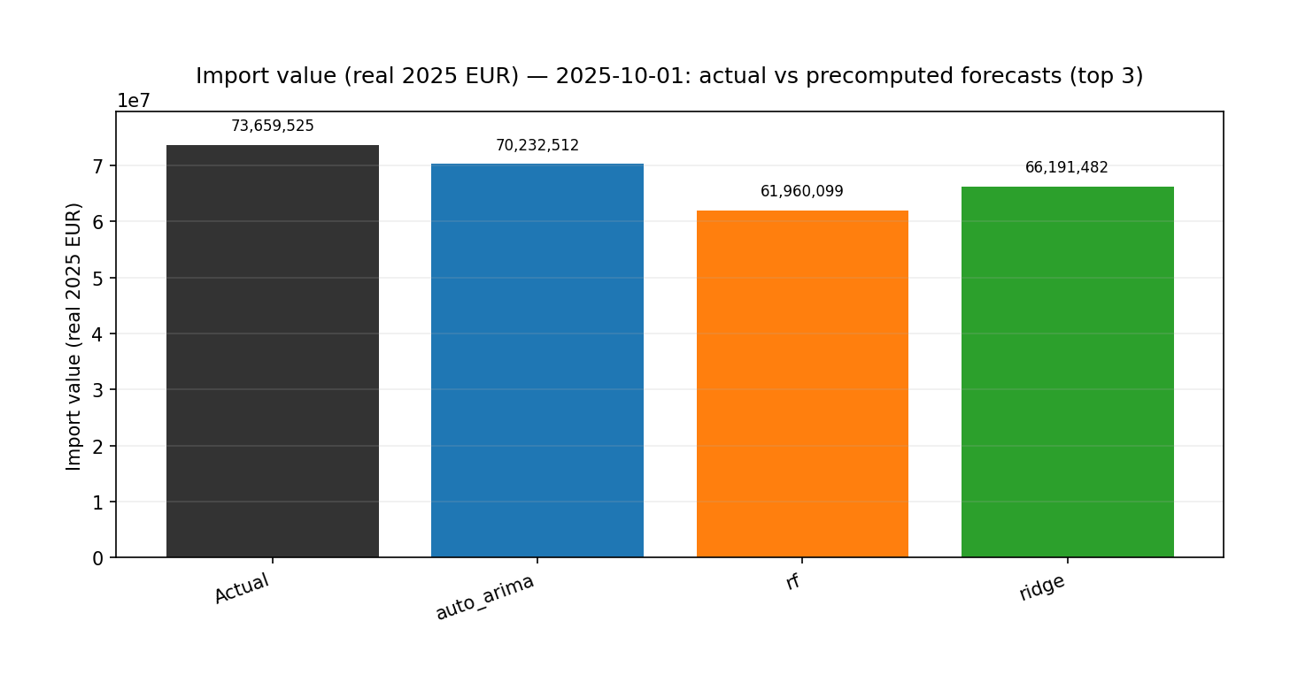
Predictions vs. Reality
9.9% increase from september to october all models underforcasted
4.6%
15.8%
10%

Slide 16
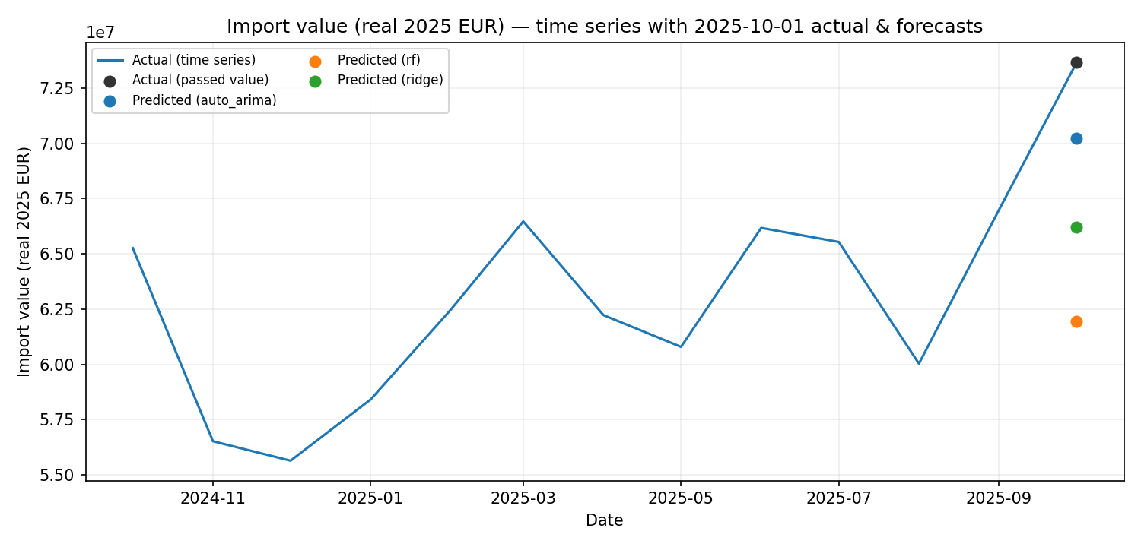
Predictions vs. Reality

Slide 17
Value
Better import planning
Separation on raw demand from price effects
especially when combining with the timeseries of the quantities
Reduced risk from assumptions
Data-driven economic interpretation

Slide 18
Questions?

Slide 19
Thx for your attention
Notes:
Inflation drives value growth more than demand
Simple models can be surprisingly strong
Combining model families yields reliable forecasts
Clear value for policy and business decisions

